Slide 1
Change Model
Implementation Strategy
Jennifer Jimenez
Grand Canyon University LDR615
December 18, 2019

Slide 2
Combination of Change Models
Lewin’s, McKinsey 7 S model, and Kotter’s change model will be appropriate for my organization.
Creation of awareness
Addressing the impacts of status quo .
Communication
Changing stage is when the real transition is made.
Learning about the new organizational culture.
The final stage will involves stabilization and reinforcement.
Notes:
Changing stage is when the real transition is made.
Individuals start learning about the new organizational culture. The initial stage entails the creation of awareness among the staff on the areas that need change. The final stage involves stabilizing and reinforcing the new state (Hussain et al., 2018).

Slide 3
Stages
Development of strategy.
Creation of structure.
Development of work systems.
Shared Values.
Style.
Staff.
Appropriate skills and efficiency.
Notes:
A strategy will be developed to outline the goals of the new change initiative and how they will be implemented. Structure of the new change model will be created to delineate the day-to-day activities of the organization. Work systems will also be developed to determine division of labor. The system will be based on shared values to ensure organizational efficiency. A unique style will be used in the change model with regard to leadership and work delegation. Appropriate staff will be recruited based on their skills and capabilities.

Slide 4
Cont.
Need for Urgency.
Team building.
Organizational vision.
Effective communication.
Getting things moving.
Goal-setting.
Determination.
Incorporation of change.
Notes:
The staff will be educated on the need of the plan to be implemented with urgency. The model will incorporate team-building strategies and utilize staff with the right mix of skills. The management will need to get the vision correct by integrating aspects such as creativity, objectives, and emotional intelligence. The management will also have to communicate with staff on the need for change. The organization will also have to get things moving with regard to empowerment and action. The organization will also have to set long-term and short-term goals and highlight how they will be achieved. The staff and leaders will have to be determined to avoid giving up after the implementation. The change will need to reinforced and made part of the workplace culture.

Slide 5
Methods of Evaluation
Patients surveys .
Medical record audits .
Interviewing the patients .
Staff survey.
Clinician surveys .
Ethnographic observations.
Environmental measures.
Financial records.
Notes:
Patients surveys will be carried out to gather information about medical outcomes.
Medical record audits will provide data on procedural and interventional outcomes.
Interviewing the patients will provide information on patient-rate care characteristics.
Staff survey will provide data on practice experience.
Clinician surveys will provide data on organizational efficiency.
Ethnographic observations will provide data on practice development (Jaen et al., 2010).
Environmental measures will provide data on the environment.
Financial records will provide data on the finances of the facility.

Slide 6
Criteria for Team Selection
Appropriate skills.
Highly experienced.
Leadership positions.
Competency.
Good communication skills.
Readiness to learn.
Goal-oriented.
Creative and flexible.
Notes:
Team members should have the appropriate skills and knowledge for the change initiative.
The team should be highly experienced.
The individuals selected should be in leadership positions.
The individuals selected should also be competent.
The persons chosen should also have good communication skills.
The team should also be ready to learn.
The team should also be oriented to achieving the new organizational goals.
The individuals selected should be creative and flexible.

Slide 7
Communication Strategies
Videoconferencing
The company’s intranet.
Emails .
Print media such as flyers.
Encouraging and motivational blog posts.
Videos and photos.
Online group discussions.
Instant messaging.
Notes:
Videoconferencing can be used to communicate the essentials of the change initiative.
The company’s intranet will also used to post important messages.
Emails can also be sent to the staff on the proposed change initiative.
Print media such as flyers can be used to present the change model.
The management can publish encouraging and motivational blog posts.
The management can also post videos and photos related to the change in the organization’s website.
Online group discussions will be used to discuss about the change.
Also, the management can send information about the change through instant messsaging.

Slide 8
Strategies for Gathering Shareholders’ Support
Comprehensive plans.
A detailed communication plan .
Conducive environment .
Actively engaging them in the change process.
Stakeholder support committees .
information about the benefits of the changes.
Information about the resisters and champions of the change initiative
Creating a positive relationship.
Notes:
Stakeholders will be provided with a comprehensive plan about the change.
A detailed communication plan will be developed at the early stages.
A conducive environment will be created for the proposed change.
Stakeholders will be actively engaged in the change process.
Stakeholder support committees will utilized to connect the change coordinator and the stakeholders.
Stakeholders will be informed about the benefits of the changes.
Stakeholders should be informed about the resisters and champions of the change initiative
A positive relationship will be established with the stakeholders

Slide 9
Strategies for Overcoming Resistance
Collaborative teams.
Skills and knowledge criterion.
Persuasion and energetic about the changes.
Showing passion about the proposed change.
Providing opportunities to provide feedback.
Positivity and supportiveness to the employees
Data to support the need for change.
Effective conflict resolution.
Notes:
Collaborative teams with common objectives will be created.
Teams will be created based on the skills and knowledge to maximize their potential.
Teams will be required to be persuasive and energetic about the changes.
The change coordinator will also be required to be passionate about the proposed change.
The staff should be give opportunities to provide feedback.
The management should be positive and supportive to the employees during the change process.
Clinicians should be provided with data to support the need for change.
Conflicts related to the change initiative will be resolved effectively.

Slide 10
Implementation Strategies
Creation of awareness .
Examination of behavioral characteristics.
The need for change.
Communication of essentials.
Implementation of the new change model.
Learning of new traits, ways of thinking, and processes.
Supporting employees.
Consolidation of the new state.
Notes:
The management will create awareness of how the existing culture impacts negatively on the organization.
Old behavioral characteristics and processes will be examined.
The analysis will help show the staff why change is inevitable.
The essentials of the change process will be communicated to the staff.
The new change model will be implemented.
Staff will be required to learn new traits, ways of thinking, and processes.
Support will be offered to the employees to make them comfortable with the new culture.
The new state will be solidified to prevent reverting to the old culture.

Slide 11
Sustainability Strategies
Regular education.
Setting attainable goals.
Regular communication .
Communication of outcomes.
Rewarding staff.
Discussing implications.
Appropriate feedback systems.
Creation of necessary infrastructure.
Notes:
The employees should be regularly educated on the new structural and cultural changes.
Attainable goals about the new model should be set.
Regular communication should be made to the team.
The outcomes of the new system should be communicated to the staff.
Staff and clinicians should rewarded for their contributing in ensuring the change.
The implications of the change should be discussed with the employees.
Staff should be given opportunities to provide feedback about the new changes.
Necessary infrastructure should be developed to support the change (Silver, McQuillan, & Chertow, 2016).

Slide 12
Relevancy to the Organization
Responsiveness to patient needs.
Improved medical outcomes.
Improved organizational efficiency.
Promotion of clinician productivity.
Reduction of delays.
Improved patient satisfaction.
Increased return on investment.
Creation of opportunities for creativity and innovation.
Notes:
The change initiative will make the organization more responsive to patient needs.
It will help improve medical outcomes.
It will help improve organizational efficiency.
It will also help promote clinician productivity.
The time for administering care will be reduced significantly.
Patient satisfaction will be improved.
There will be an increased return on investment.
The change initiative will create opportunities for creativity and innovation.

Slide 13
Why it will work?
Smooth transition from one culture to another.
Improved productivity and the morale.
A correct perception about care will be created.
Minimal resistance.
Cooperation and collaboration.
Optimal care outcomes.
Reduced stress and anxiety.
Positive opportunities.
Notes:
The change initiative will work since it will enable smooth transition from one culture to another.
The productivity and the morale of the employees will be improved.
A correct perception about care will be created.
Resistance to the new change model will be minimal.
Cooperation and collaboration among clinicians will be improved.
Optimal care outcomes will be achieved.
Stress and anxiety among the staff will be minimized.
Positive opportunities will be created for care improvement.

Slide 14
Sustainable Change
Effective communication strategies .
Employee acceptance .
Employee loyalty .
Customer satisfaction.
Careful planning and follow up.
Room for modification.
Stakeholders, suppliers, and customers engagement.
Reduced possibilities for failure.
Notes:
Effective communication strategies will be put in place.
Employee acceptance will be prevalent in the long-term.
Employee loyalty will be enhanced due to improve care environment.
Customer satisfaction will be achieved after the implementation of the change initiative.
The change will be supported with careful planning and follow up.
The change model will create room for modification.
Stakeholders, suppliers, and customers will comprehend the need for change.
The possibilities for failure will be reduced.

Slide 15
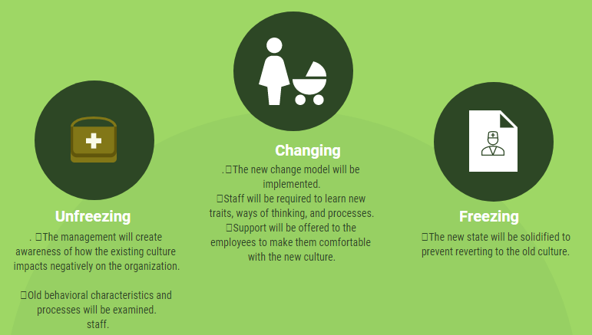
The Proposed Change Initiative

Slide 16
References
Hussain, T. S., Lei, S., Akram, T., Haider, J. M., Hussain, H. S., & Ali, M. (2018). Kurt Lewin’s change model: A critical review of the role of leadership and employee involvement in organizational change. Journal of Innovation & Knowledge, 3(3), 123-127.
Jaen, C. R., Crabtree, B. F., Palmer, R. F., Ferrer, R. L., Nutting, P. A. Miller, W. L….Stange, K. C. (2010). Methods of evaluating practice change toward patient-centered medical home. Annals of Family Medicine, 8(4), 1-12.
Silver, A. S., McQuillan, & Chertow, M. G. How to sustain change and support continuous quality improvement. Clinical Journal of American Society of Nephrology, 11(5), 916-924.

